Slide 1
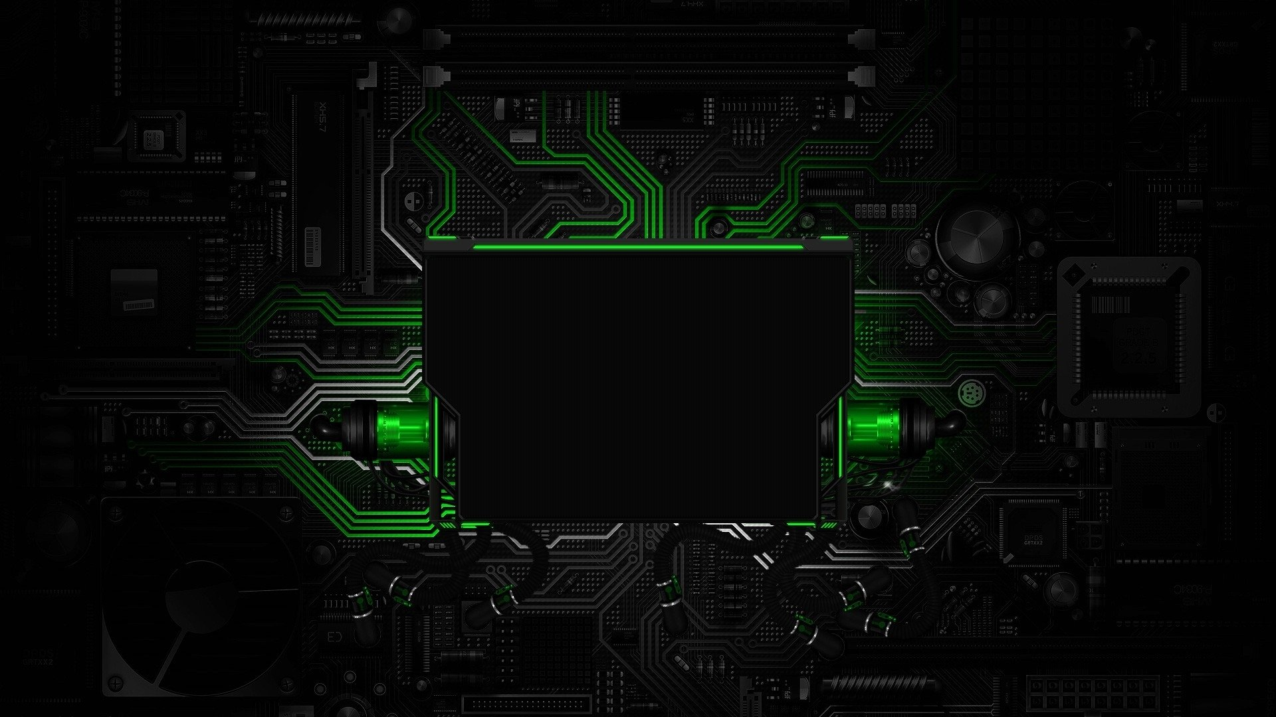
COMPUTER HARDWARE
Computer hardware includes the physical parts of a computer, such as the case, central processing unit (CPU), monitor, mouse, keyboard, computer data storage, raphics card, sound card, speakers and motherboard.
By contrast, software is the set of instructions that can be stored and run by hardware. Hardware is so-termed because it is "hard" or rigid with respect to changes, whereas software is "soft" because it is easy to change.
Hardware is typically directed by the software to execute any command or instruction. A combination of hardware and software forms a usable computing system, although other systems exist with only hardware.

Slide 2

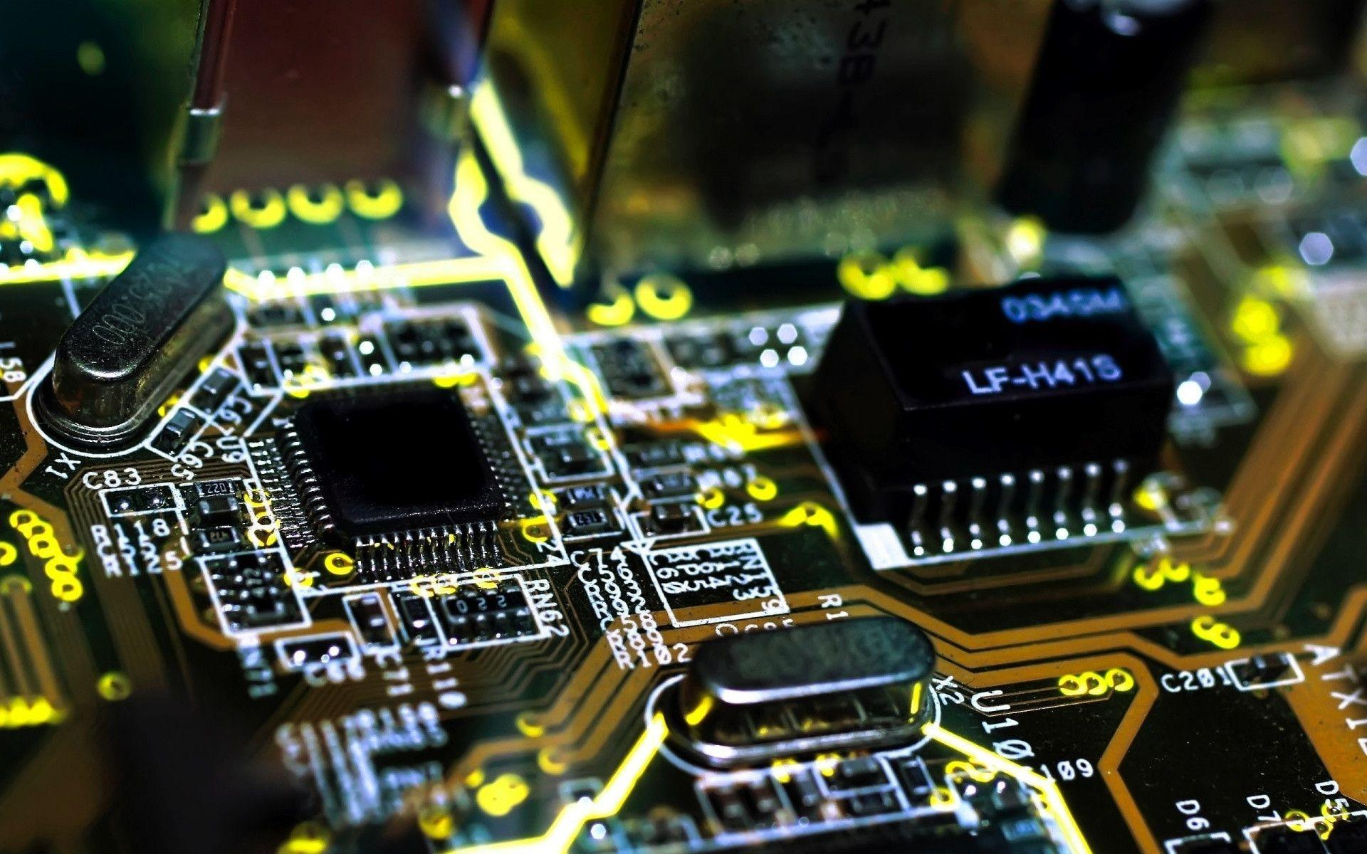
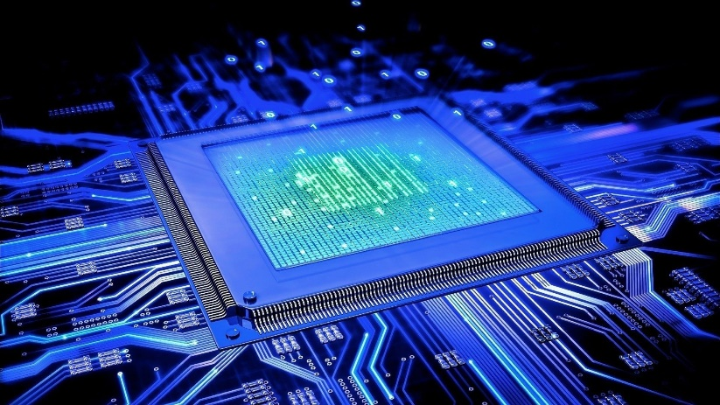

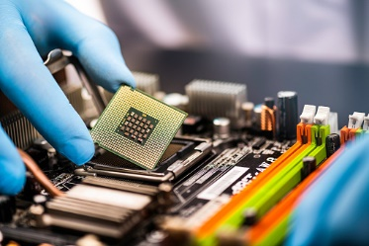
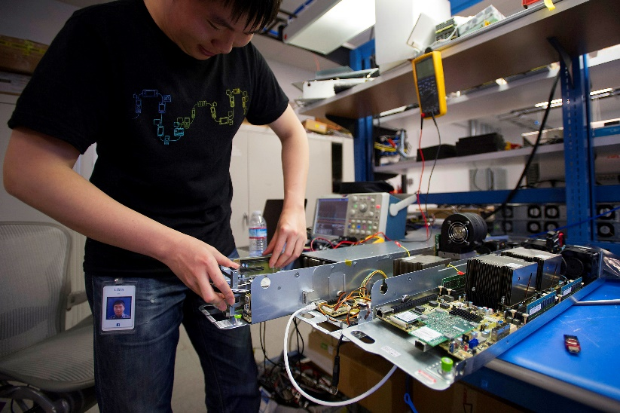
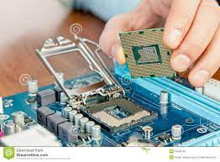
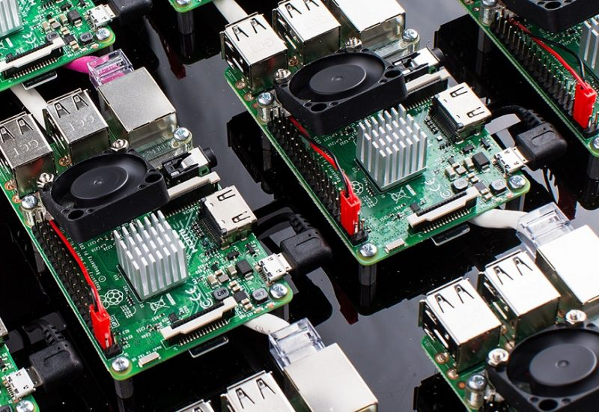
HARDWARE IMAGE

Slide 3
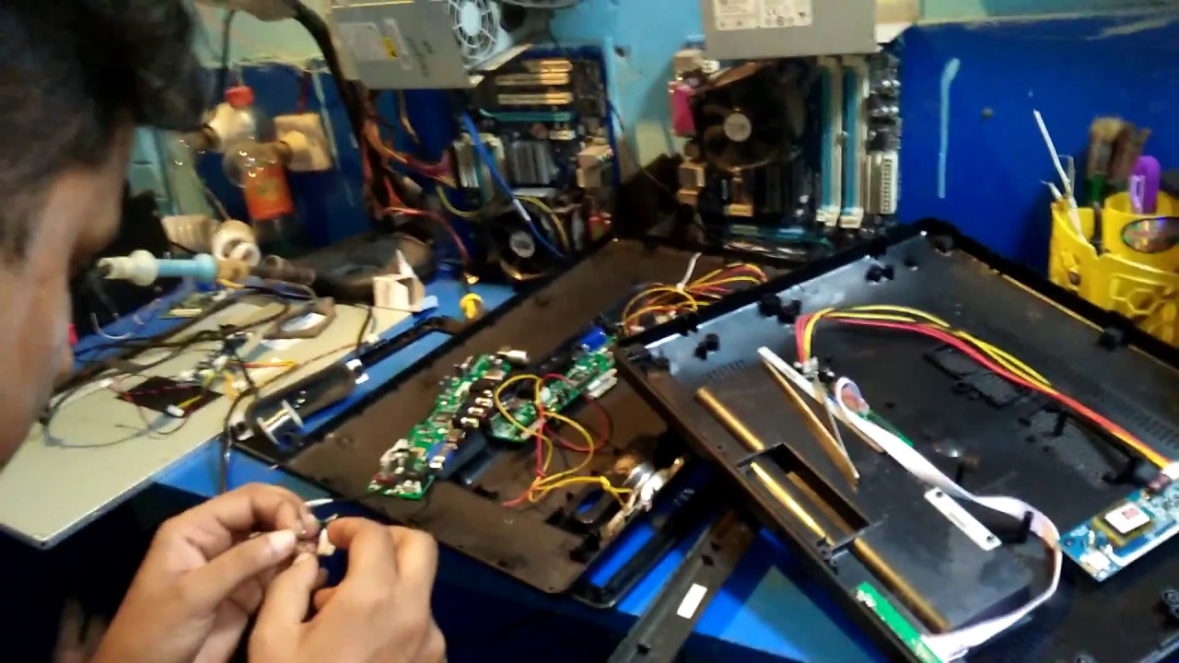
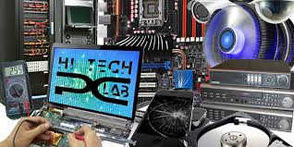

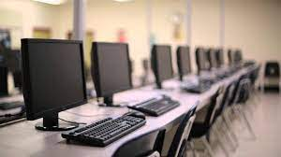

Slide 4
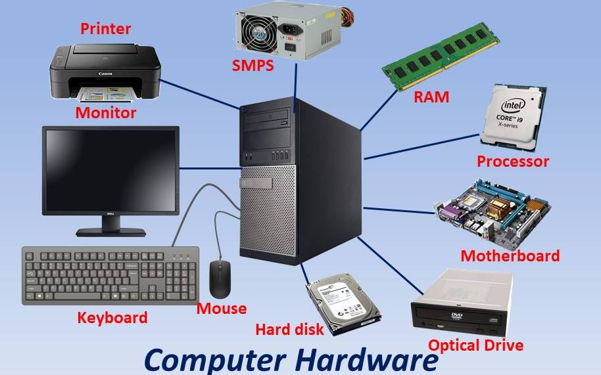

Slide 5
